Slide 1
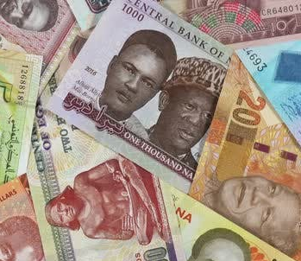
Which factors are most associated with Systemic Crises in Africa?
Group Members: Tola Adesomoju, Rohit Sajnani and Leban Mahamoud
Leban
Notes:
Riyazh

Slide 2
FACTS ABOUT THE DATA
This is the study for 13 African Countries.
The data is from 1860 to 2014
The data gives various economic indicator across these 13 countries e.g:
domestic_debt_in_default
sovereign_external_debt_default
gdp_weighted_default
inflation_annual_cpi
currency_crises
inflation_crises
Leban
Notes:
Algeria
Angola
Central African Republic
Egypt
Ivory Coast
Kenya
Mauritius
Morocco
Nigeria
South Africa
Tunisia
Zambia
Zimbabwe

Slide 3
Business Problem Reasoning
Angola: Angola has the fourth highest inflation rate in Africa at 29.7%.
Nigeria: Africa's biggest economy has an inflation rate of 17.59%.
Conversion rates from USD to perspective African countries(found on exchange rates.org)
1 USD equals 410.24 Nigerian Naira
1 USD equals 597.01 Angolan Kwanza
Zimbabwe: At 50%, Zimbabwe's inflation rate is the second highest in Africa.
Leban

Slide 4
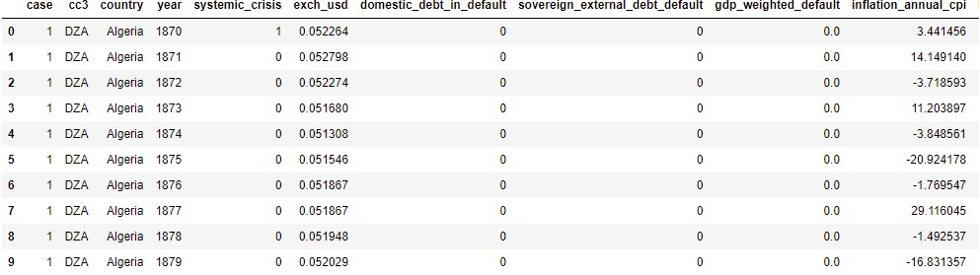
Dataset
Head
Leban

Slide 5
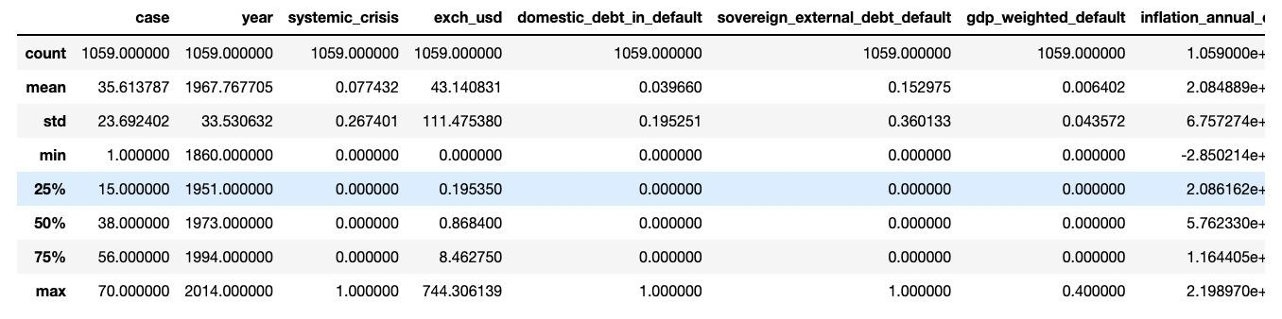
Dataset
Describe
Rohit
Notes:
Exchange rate 744 is for Central african Republic

Slide 6
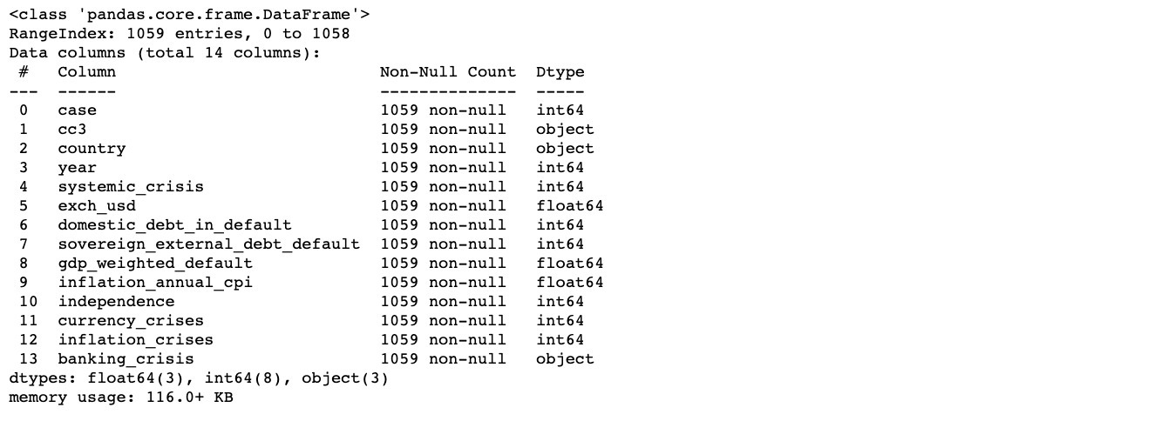
Dataset Cleaning
Rohit
Notes:
Paul

Slide 7
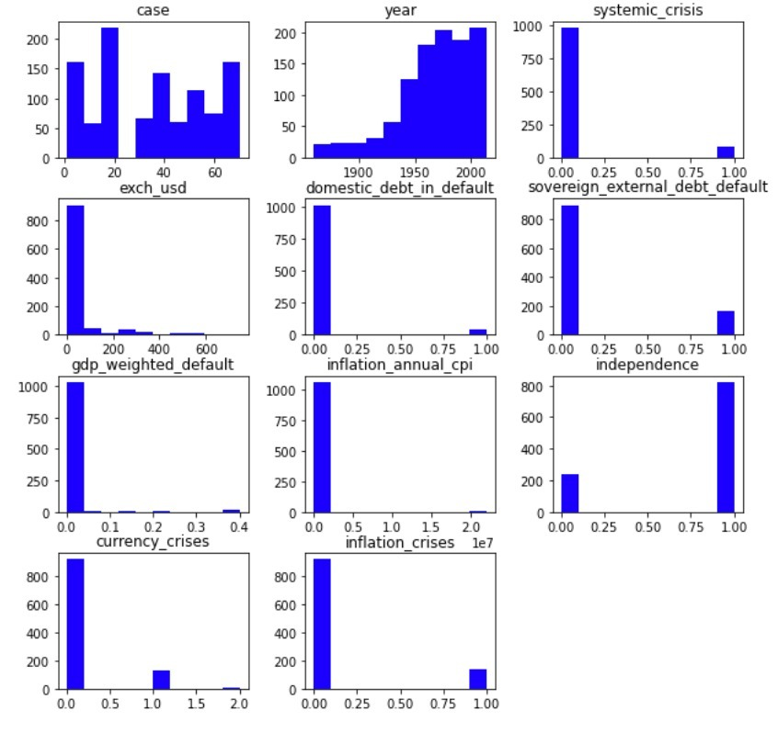
Histogram
Rohit

Slide 8
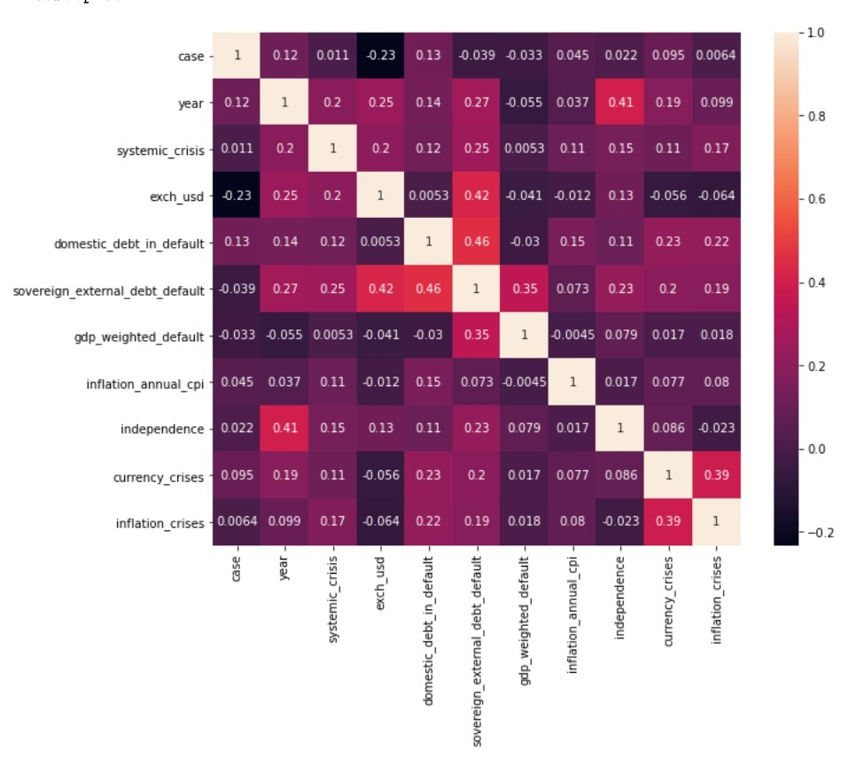
Heatmap
Rohit

Slide 9
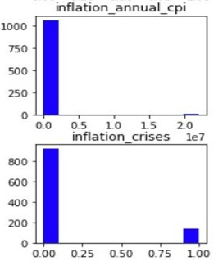
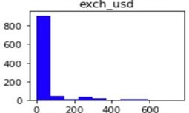
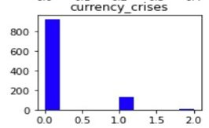
Machine Learning Algorithm- Independent Variables
Namely inflation_annual_cpi, exch_usd, inflation_crises, currency_crises
Model 1 Random Forest Module
Takes away hassle to normalize the data
Provides the flexibility for classification
Model 2 Nearest Neighbour Classifier (KNN)
Algorithm requires no training before making predictions
New data can be added seamlessly without drastically impacting Accuracy
Model 3 Decision Tree
Decision tree makes it easy to work with data like this with fewer preparations
Ease in data preparation
Rohit

Slide 10

Machine Learning Algorithm
Random Forest
Nearest Neighbour
Decision Tree
Tola
Notes:
Tola

Slide 11
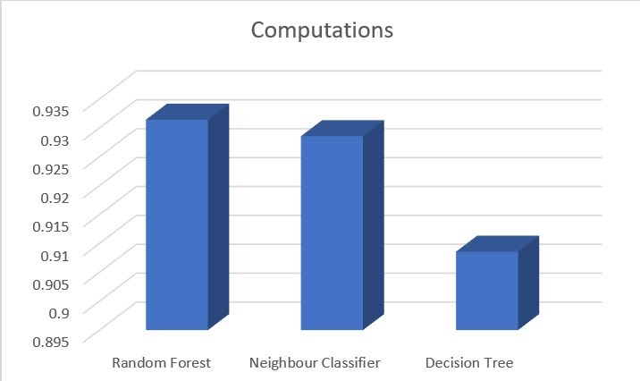
Machine Learning Algorithm- Scores
Random Forest: 0.9314285714285714
Nearest Neighbour: 0.9285714285714286
Decision Tree: 0.9085714285714286
Tola
Notes:
Tola

Slide 12
Conclusion
We can see that from out 3 methodologies that testing using the Random Forest program we received a larger score when compared to the other 2 programs listed. A possible reason for the differences could be that we used 1000 trees in our "n_estimators=1000" for our Random forest.
Another possible reason could be that the maximum depth of the tree was set to a specific number rather than letting value populate until all leaves contain less than min_samples_split samples.
Tola
Notes:
Tola

Slide 13
Conclusion - Contd
I believe that our models and indicators are good predictors on whether the systemic crisis of these African Countries are affected by the variables we chose from the data set. Namely "inflation_annual_cpi", "exch_usd", "inflation_crises", "currency_crises"
Tola

Slide 14
Sources
Benson, Emmanuel. “8 African Countries with the Highest Inflation Rates in 2021.” Business Insider, Business Insider, 21 Oct. 2021, https://africa.businessinsider.com/local/markets/8-african-countries-with-the-highest-inflation-rates-in-2021/jwn88vs.
Chiri. “Africa Economic, Banking and Systemic Crisis Data.” Kaggle, 21 July 2019, https://www.kaggle.com/chirin/africa-economic-banking-and-systemic-crisis-data.
“Exchange-Rates.org World Currency Exchange Rates and Currency Exchange Rate History.” Edited by ExchangeRates, US Dollar Exchange Rates - Africa - Current Exchange Rates, https://www.exchange-rates.org/currentRates/F/USD.
Tola
Notes:
R

Slide 15

Tola
Notes:
R

Slide 16
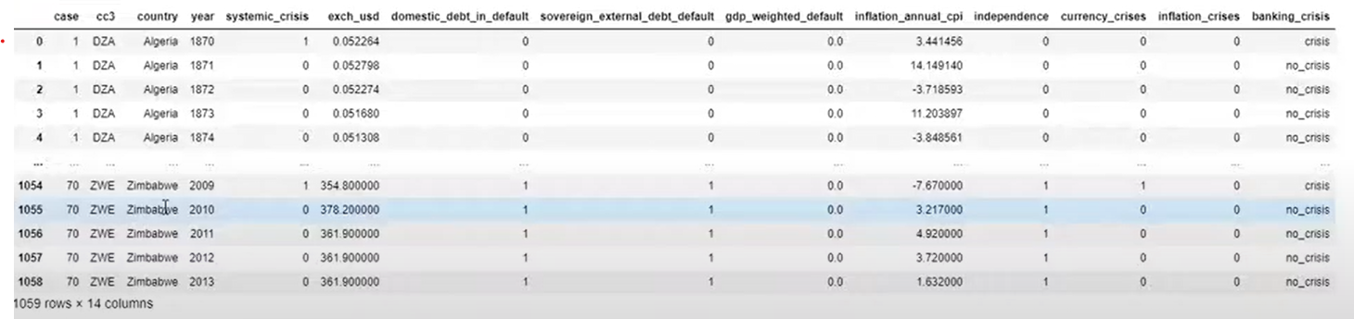
Dataset Describe
Rohit
Notes:
Paul

